Slide 1
Lecture 19
Hyperparameters and Model Validation

Slide 2
Learning Objectives Today
Model Validation
Hyperparameters

Slide 3
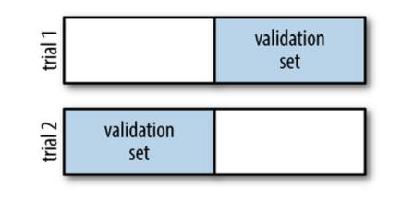
Model Validation
Dividing data into training and testing set may reduce performance for smaller dataset
What if we deploy the total dataset for training?

Slide 4
Two-fold Cross Validation
Check the script “Lecture19_Scripts1.ipynb”

Slide 5
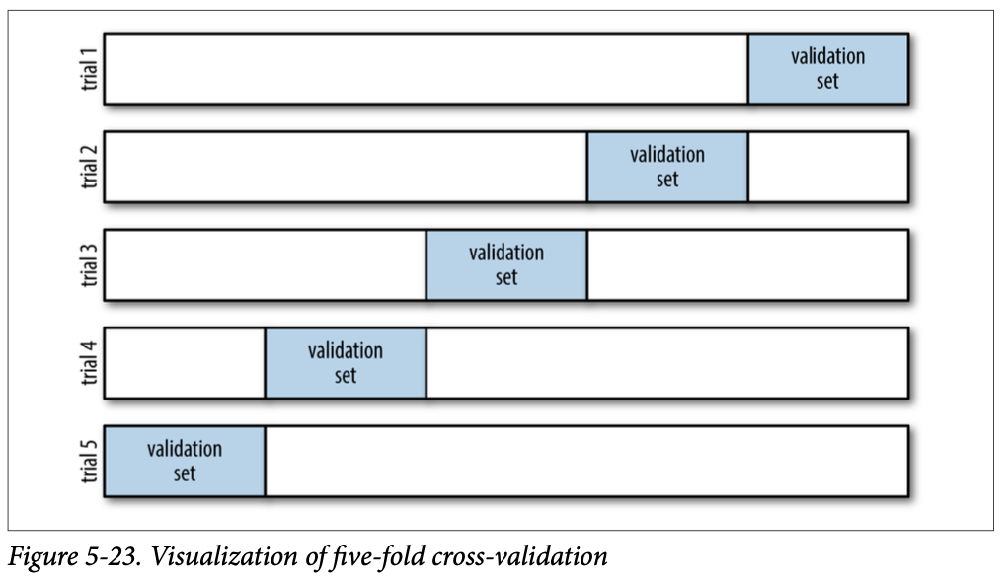
Five-fold
Check the script “Lecture19_Scripts1.ipynb”

Slide 6
Leave-One-Out Cross Validation
Check the script “Lecture19_Scripts1.ipynb”

Slide 7
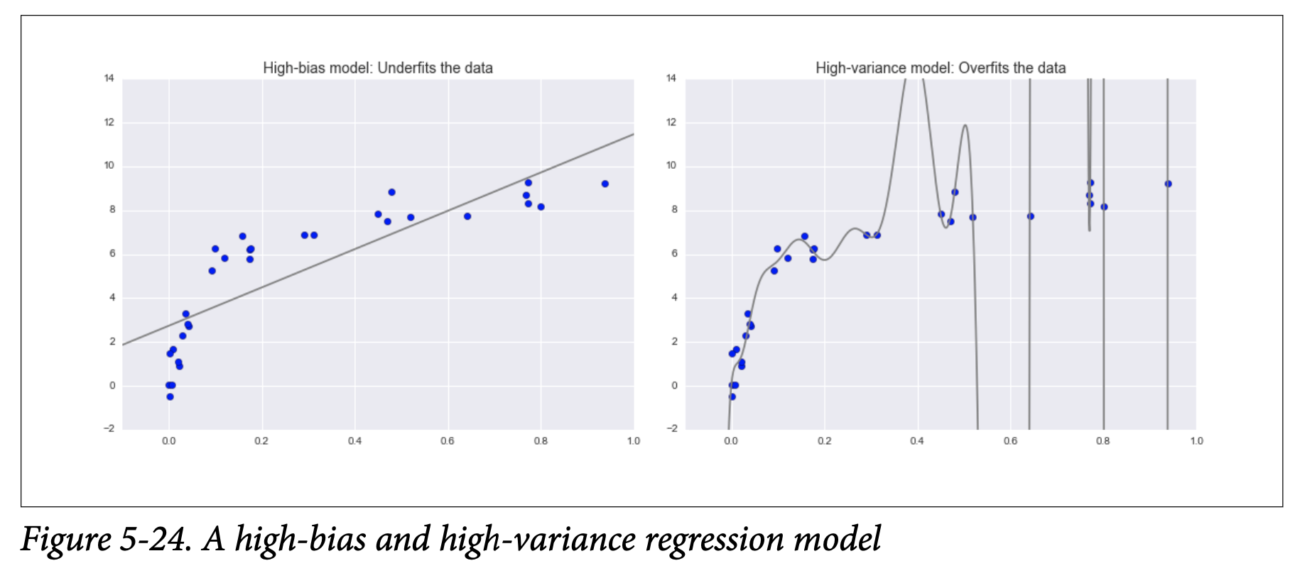
Best-Model?

Slide 8
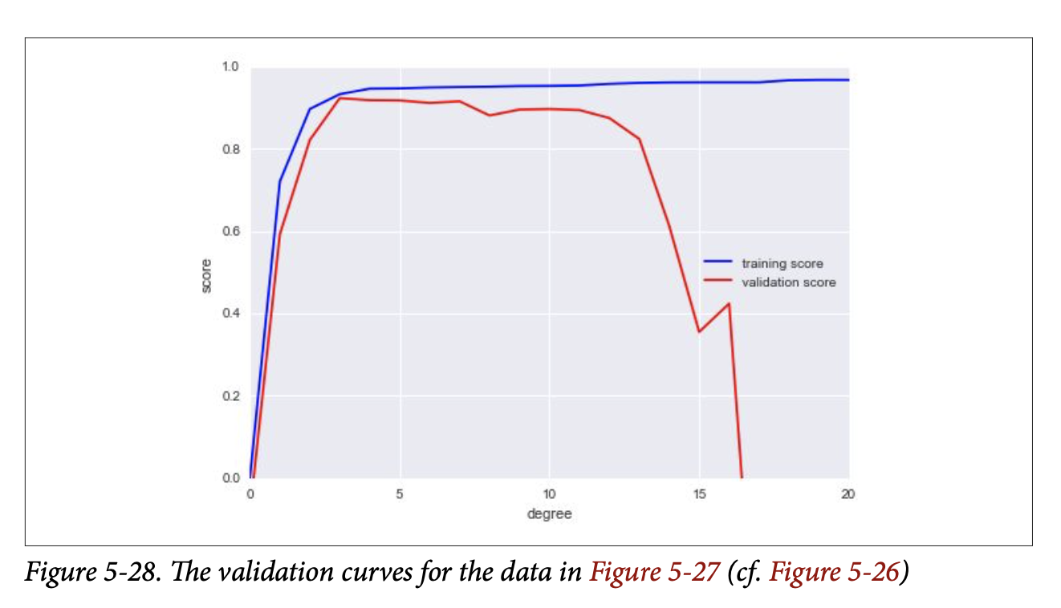
Validation Curve

Slide 9
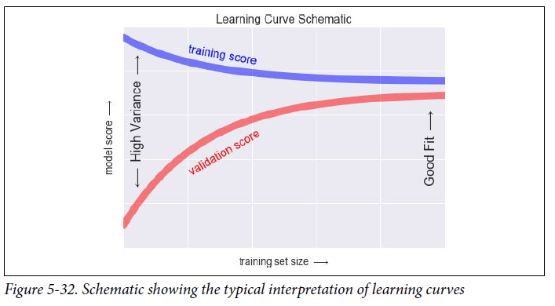
Learning Curve

Slide 10
Grid Search
Check the script “Lecture19_Scripts3.ipynb”

